Slide 1
HP Performance Center
Chitra Chinnusamy

Slide 2

Agenda
01
Understanding PC and Advantages over Controller.
02
PC Overview
03
Test Plan window overview
04
Scripts upload and Design Scenario
05
Test Execution & Test Run Window
06
Controller overview

Slide 3
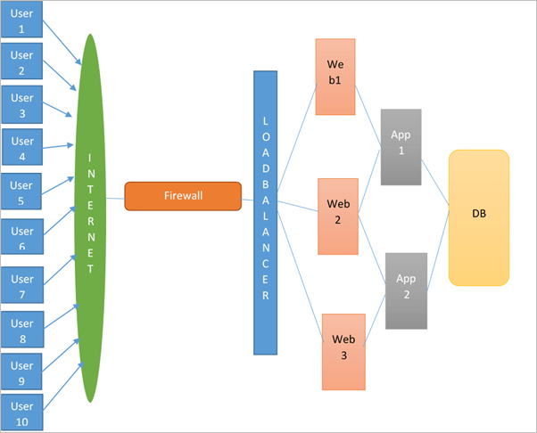
HP Performance Center
Role of HP performance Center
Simulating real user behavior for the application under test.
Designing the different kind of scenarios for testing the application.
Viewing the live user experience in addition also the application behavior.
Collating the virtual users (vusers) experience i.e. generating the raw results files.

Slide 4
Performance Center, Difference & Benefits
What is Performance Center ?
web-enabled performance testing tool designed to simulate a real time scenario for the application under test.
Few examples:-
  to simulate a 1000 users
  performing fund transfer action multiple times on Net Banking
  Booking tickets via Railway ticket booking portal.
  Buying products over ecommerce website during sales season.
LR Controller v/s Performance Center
Controller | Performance Center
stand-alone component of LR, require dedicated resources | web-based platform, globally accessible, 24x7 availability
Can execute only 1 test at a time. | Can execute multiple tests at the same time simultaneously (based on resource availability)
High dependency on host machine | Independent of host machine
Licenses and resources are distributes across various projects | Licenses and resources are consolidated into one central, easily accessible pool
Poor visibility of what a performance tester is doing | Better visibility of what a performance tester is doing

Slide 5

Performance Center, Difference & Benefits
Key Features and Benefits
Lowers the cost of distributed load testing by providing a solution that can be accessed via the Web, providing 24x7 access to a shared testing infrastructure.
Centralized pooling of license, resources and storage of test results .
Provides project-level visibility and collaborative working environment to all members of an application team.
Only 1 installation to maintain for the latest version / patch level.

Slide 6
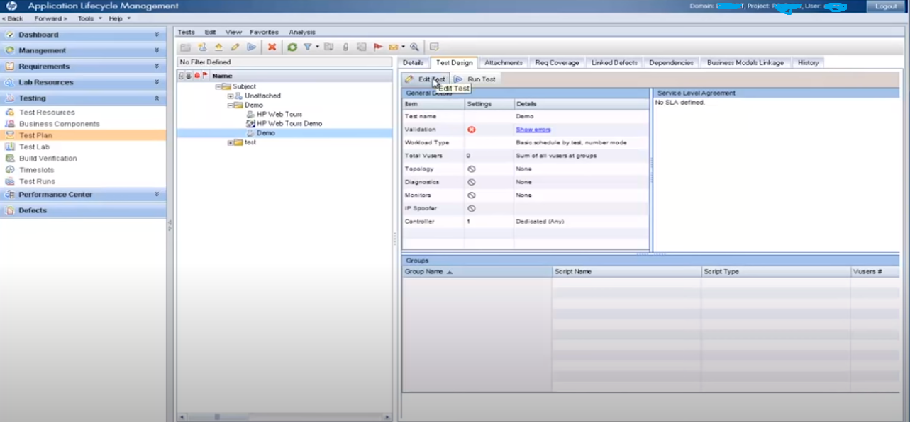
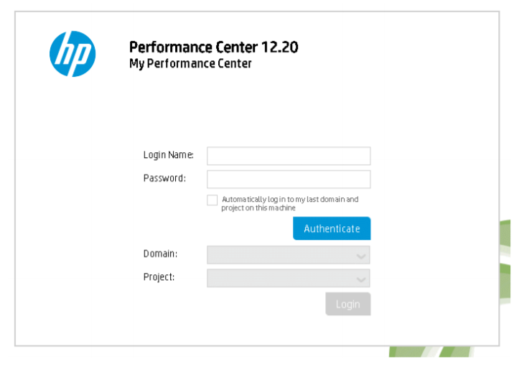
PC - Overview
PC Login page
    Enter the credentials and project details
Post Login page

Slide 7
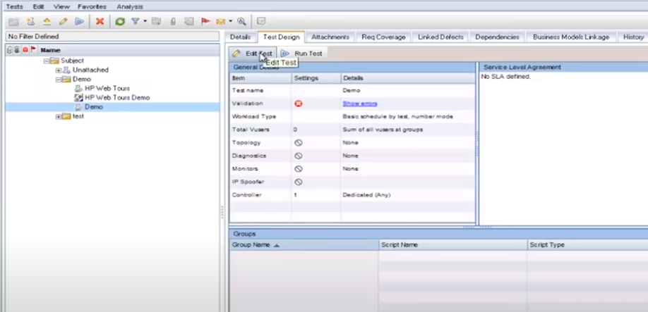
PC – Test Plan Window Overview
4. Delete
5. Refresh
2. Upload scripts
Create – to create folder
Upload scripts – to upload newly created scripts
Create Test – to create new scenario
Delete – to delete script/scenario/folder
Refresh – to refresh the tree structure
1. Create folder
3. Create Test scenario

Slide 8
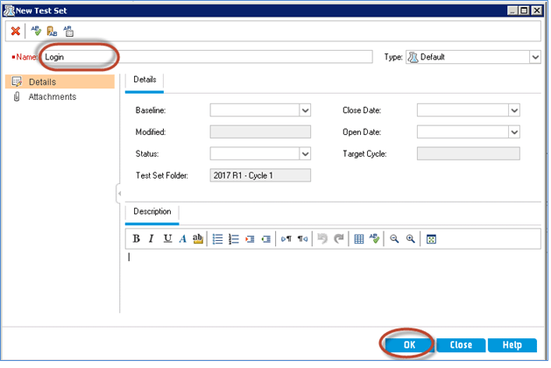
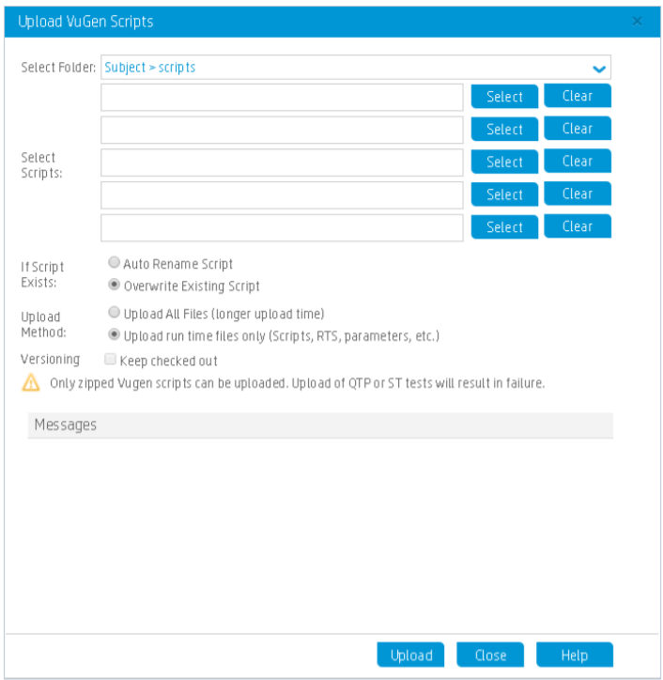
PC – Script upload & Design Scenario
After Clicking on upload button
    Scripts should be uploaded in *.zip format
    5 scripts can be uploaded at a time.
After clicking Create test scenario
    After clicking on OK, select the test scenario, click on the Design -> Edit Test button in the right pane. This will open the test scenario window to design the scenario

Slide 9
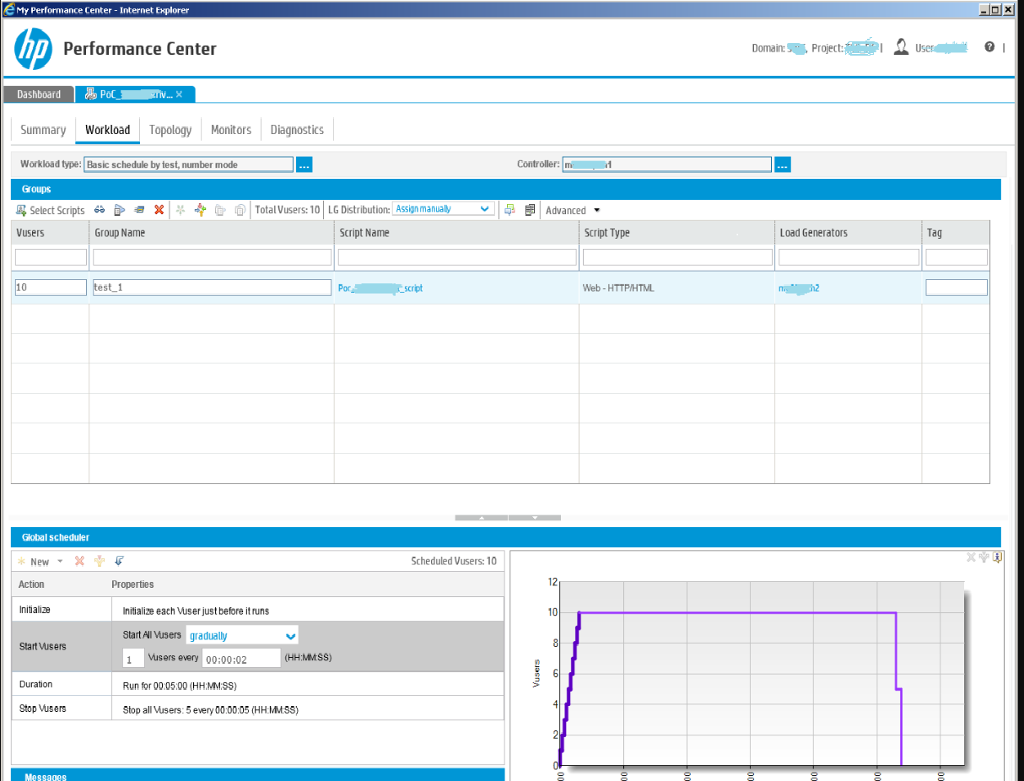
PC – Script upload & Design Scenario
Test scenario window
Scenario name
Run time setting
script
Select LG
Ramp-up,
steady state, ramp down

Slide 10
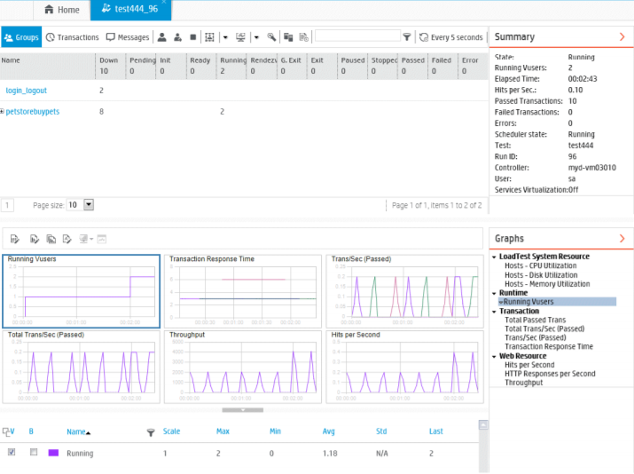
PC – Test Execution & Test Run Window
Test Execution Window
Vusers’ status
Transaction status
Run Summary
Info / Warning / error
messages
Run-time Monitors display window
Different monitoring graphs
Response time

Slide 11
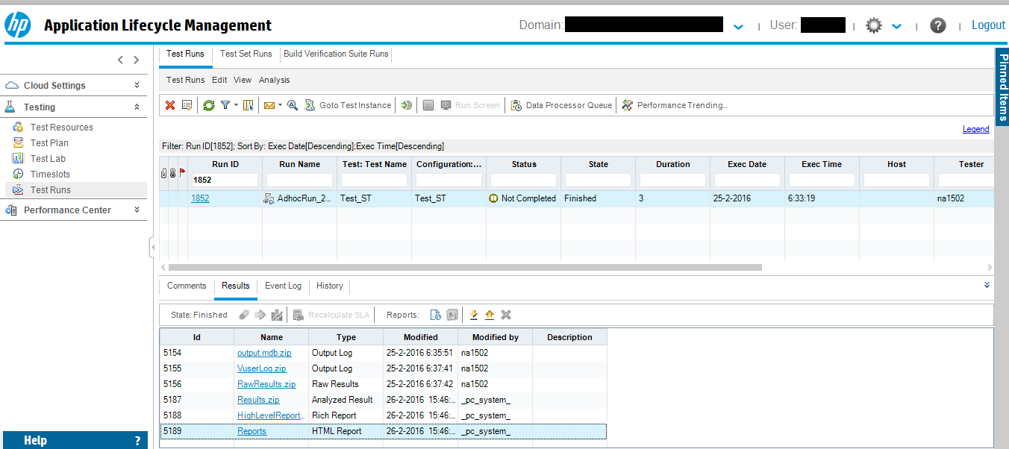
PC – Test Execution & Test Run Window
Test Run Window
    Each test executed in PC have a unique Run ID generated.
    After the test completion, results needs to be collated (if not collated automatically).
    Download the results and open in LR Analysis
Collate result
Download

Slide 12
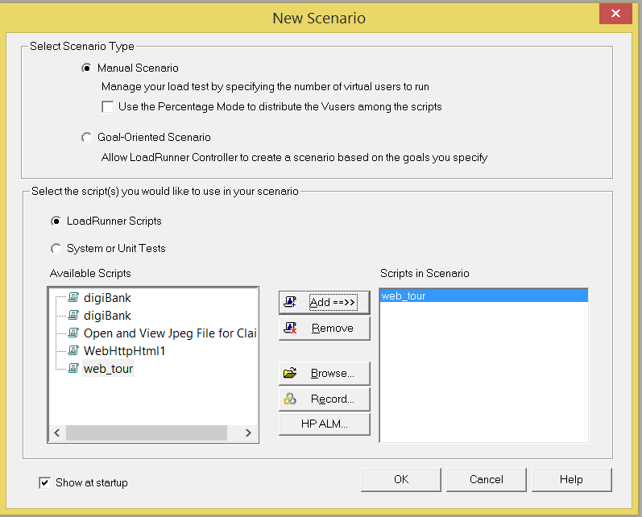
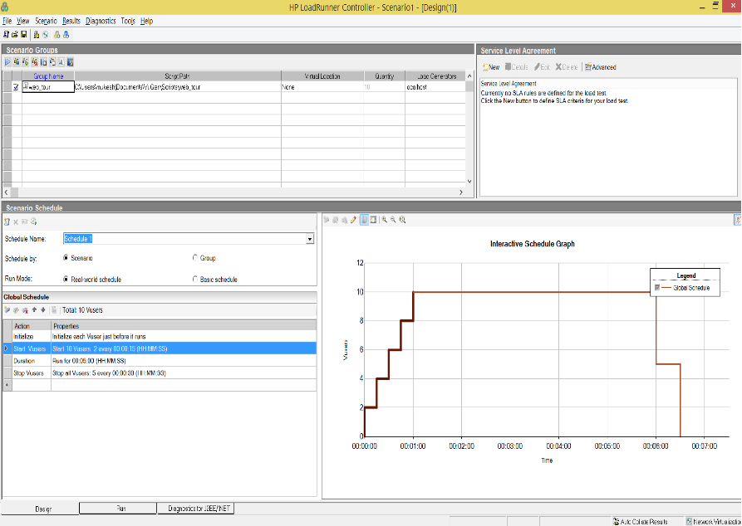
Controller Overview
    Creating LoadRunner Scenario
    Select the scripts => click Add
    Test Scenario window
Click Ok

Slide 13
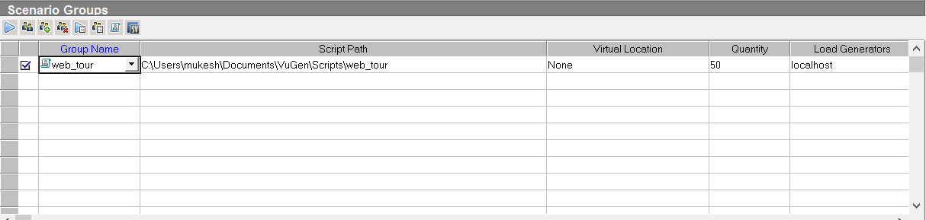
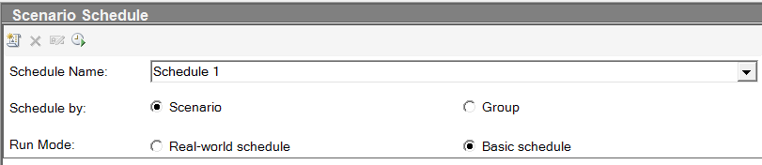
Controller Overview
Scenario Group
Add/remove group
Run time setting
Vuser status
Group Info
View script
Vuser count
Select LG
Run
Scenario Schedule
  Schedule by
    Scenario – same schedule assign to all groups
    Group – schedule assign to each group
  Run Mode
    Real-world schedule - different ramp-up rates and run duration can be applied
    Basic schedule – singe ramp-up and run duration is set for each/all groups

Slide 14
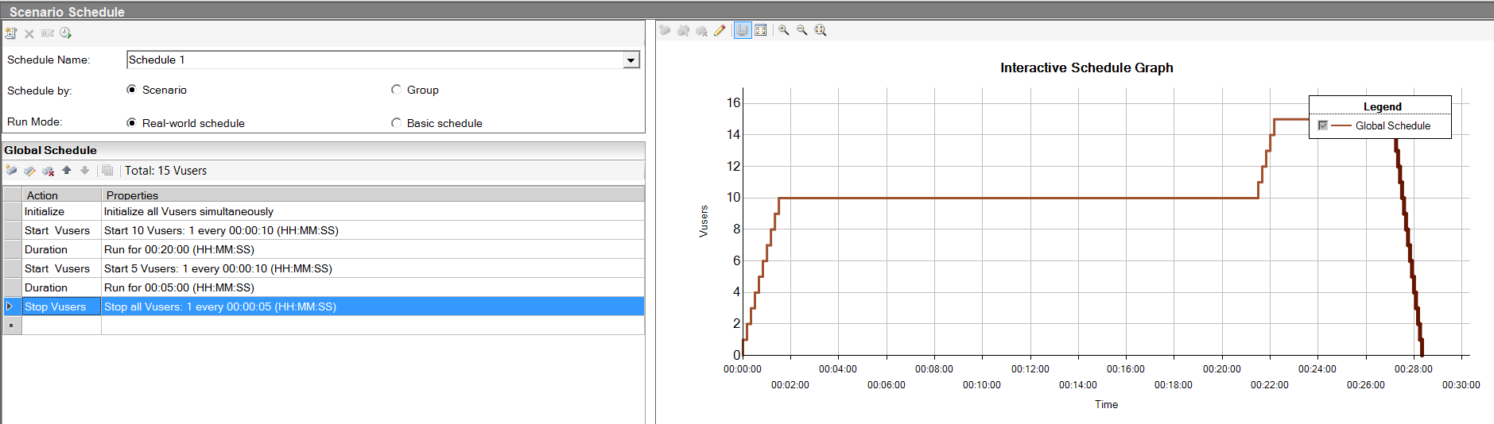
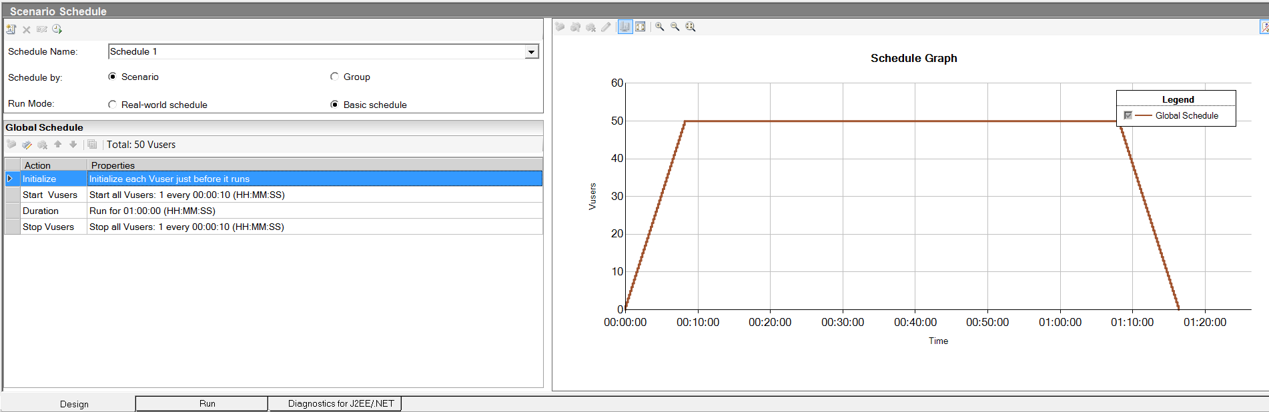
Controller Overview
Real-world schedule scenario
Basic schedule scenario

Slide 15
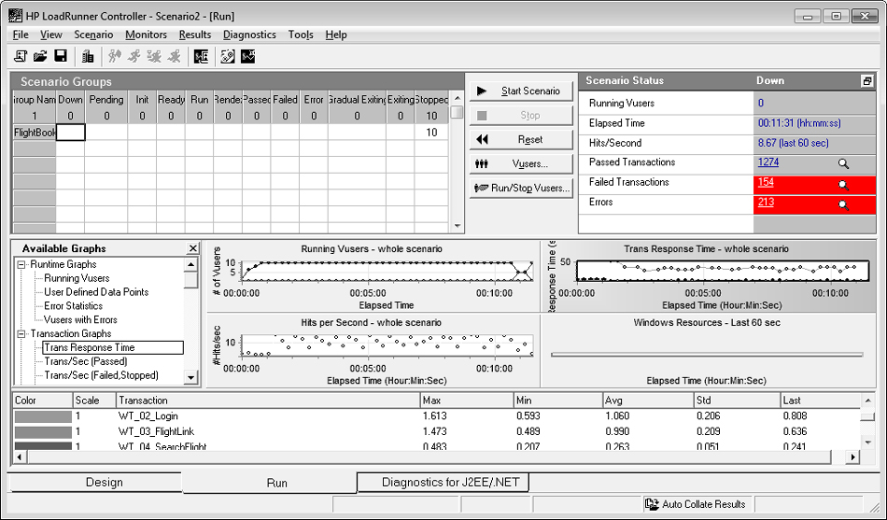
Controller Overview
Execution Window
Vusers’ status
Run summary
Available Monitors graphs
Run-time Monitors display window
Response time

Slide 16
Thank you for your time

